Slide 1
Simulation and Limitation Analysis of Modern Delay-Tolerant Email
Deng Pan
Notes:
Hello professors, I’m here to introduce my final-year project, which is called “Simulation and Limitation Analysis of Modern Delay-Tolerant Email.” The key words here are “Email” and “Delay-Tolerant.” First, I’d like to start by introducing the first keyword—Email.

Slide 2
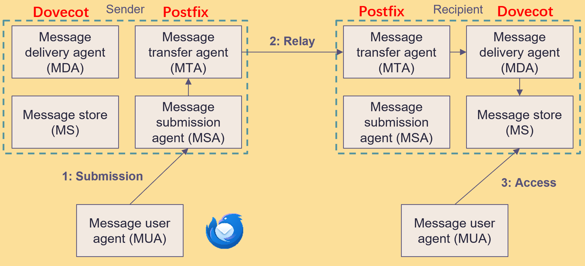
How do the email systems work?
The MUA is the client app, like Thunderbird.
These in the box are server-side apps, like Postfix and Dovecot.
Alice wrote an email in Thunderbird → Thunderbird hands it to the server → The Postfix delivers it to the recipient’s server → The Dovecot store it in MS → The recipient’s Thunderbird picks it up so Bob can read it.
Notes:
Brian Contreras

Slide 3
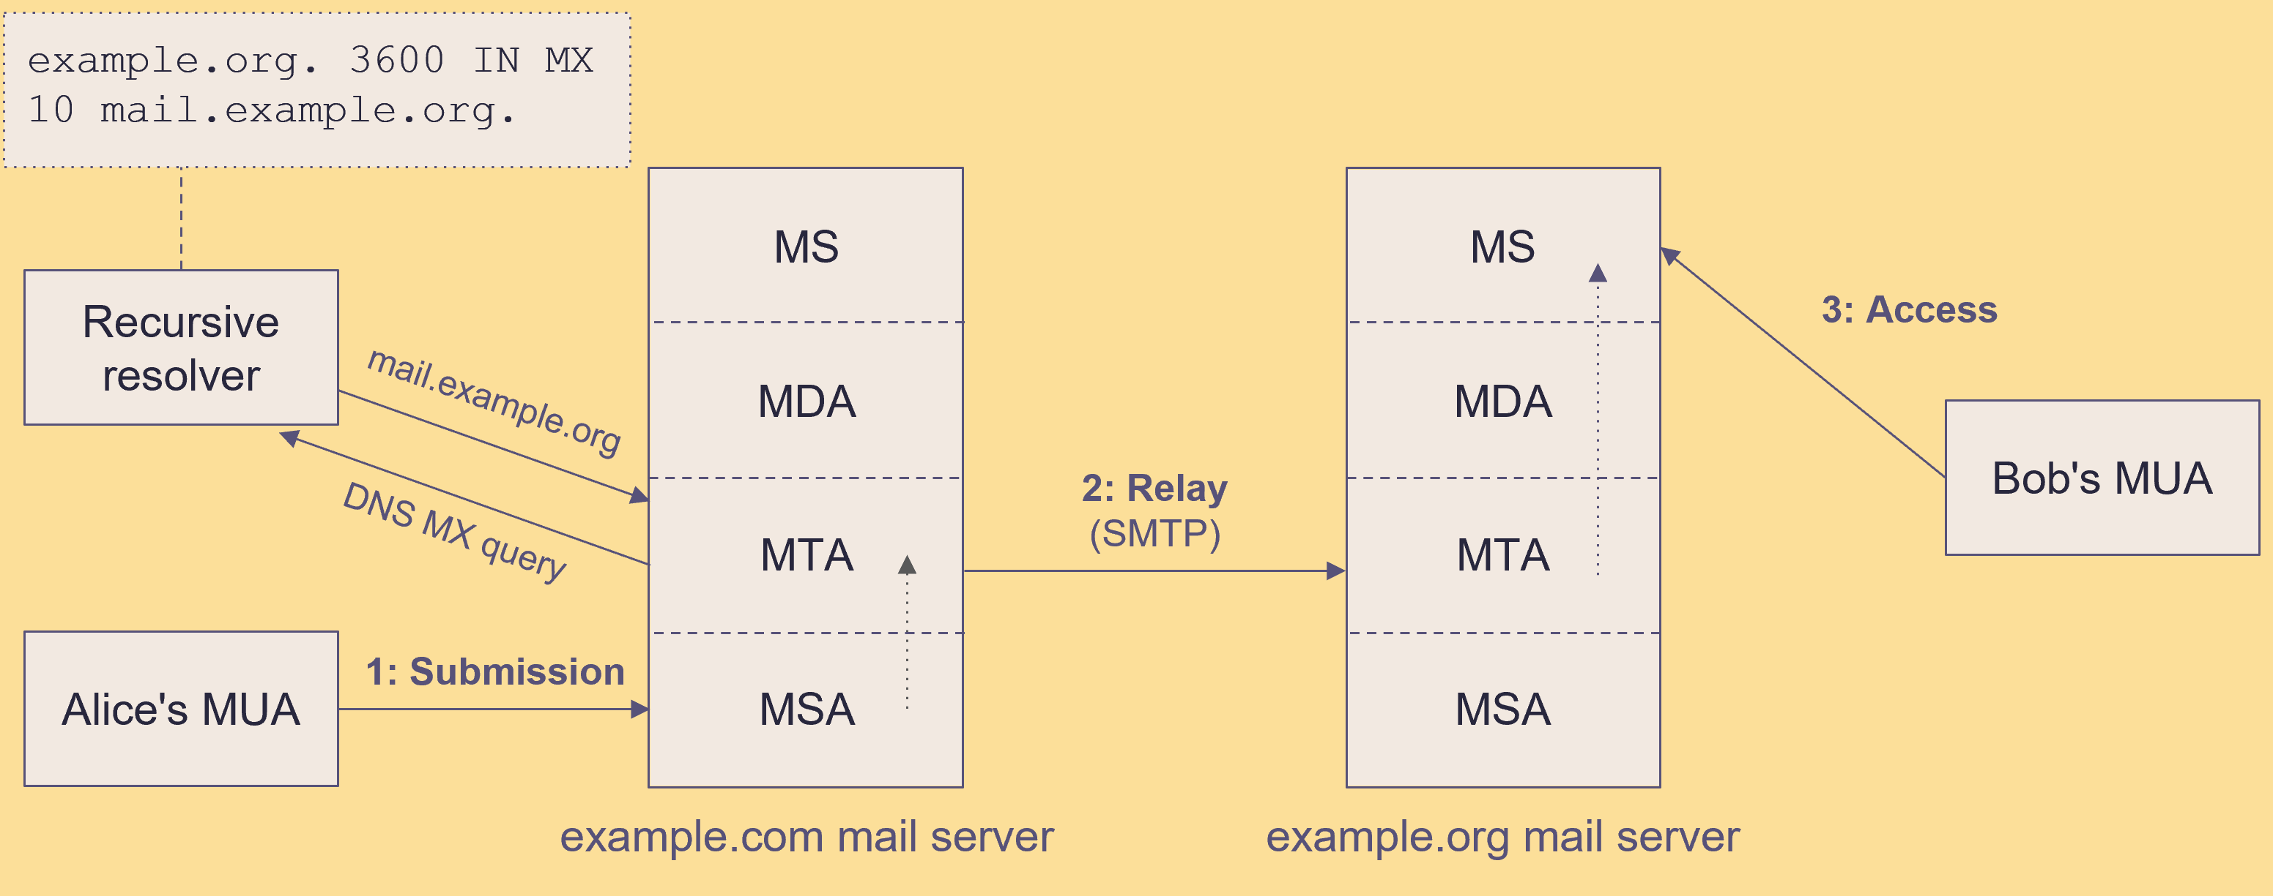





How the email systems work?
Client → Mail Server → Mail Server → Client
Thunderbird
Postfix
Thunderbird
Notes:
Of course, before the MTA sends the email to the next mail server, it first needs to query the DNS. Then, it uses the SMTP protocol to deliver the email.

Slide 4
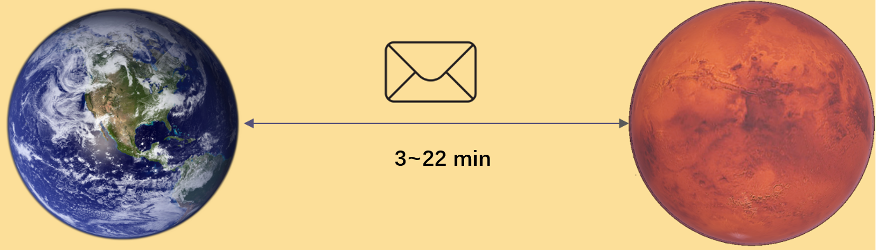

The features of space networks
Since the two planets are very far from each other. (it takes light several minutes to travel from Earth to Mars), we need a lot of satellites in between to pass along the signal. Plus, these satellites are always moving, so the network can sometimes break the signal. Because of this, space networks usually have two main features: high delays and frequent disruptions.
Notes:
Brian Contreras

Slide 5
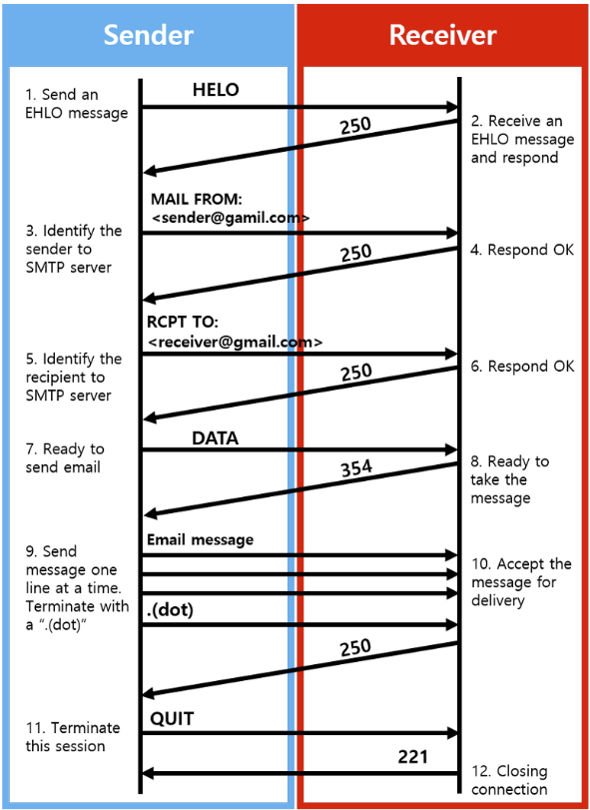
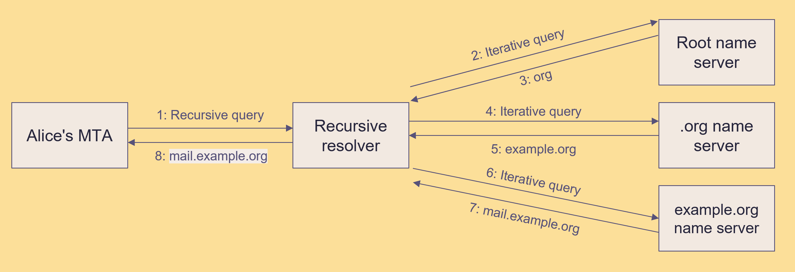
Why don’t traditional email systems work?
Traditional email uses SMTP to send messages, and SMTP itself is based on TCP/IP. They rely on low-latency, uninterrupted networks, because their communication process relies on multiple handshakes. However, space networks have high delays and frequent disruptions, making these traditional systems unreliable in such environments.
A lot of Round-Trips
Notes:
Brian Contreras

Slide 6
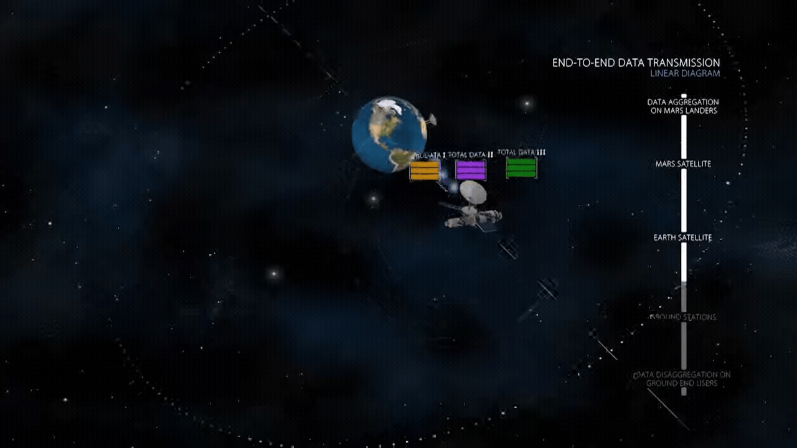
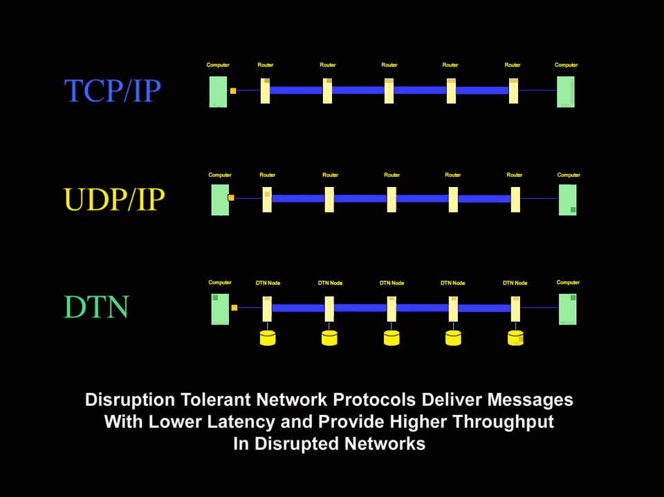
How can we solve the problems?
DTN (Delay Tolerant Network) uses “store and forward” technology. This means when the network is disconnected, it will temporarily save the data packets. Once the connection is back, it sends the packets to the next node.
Notes:
Brian Contreras

Slide 7
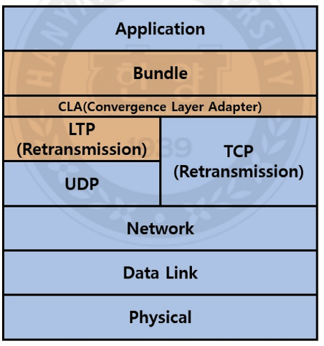
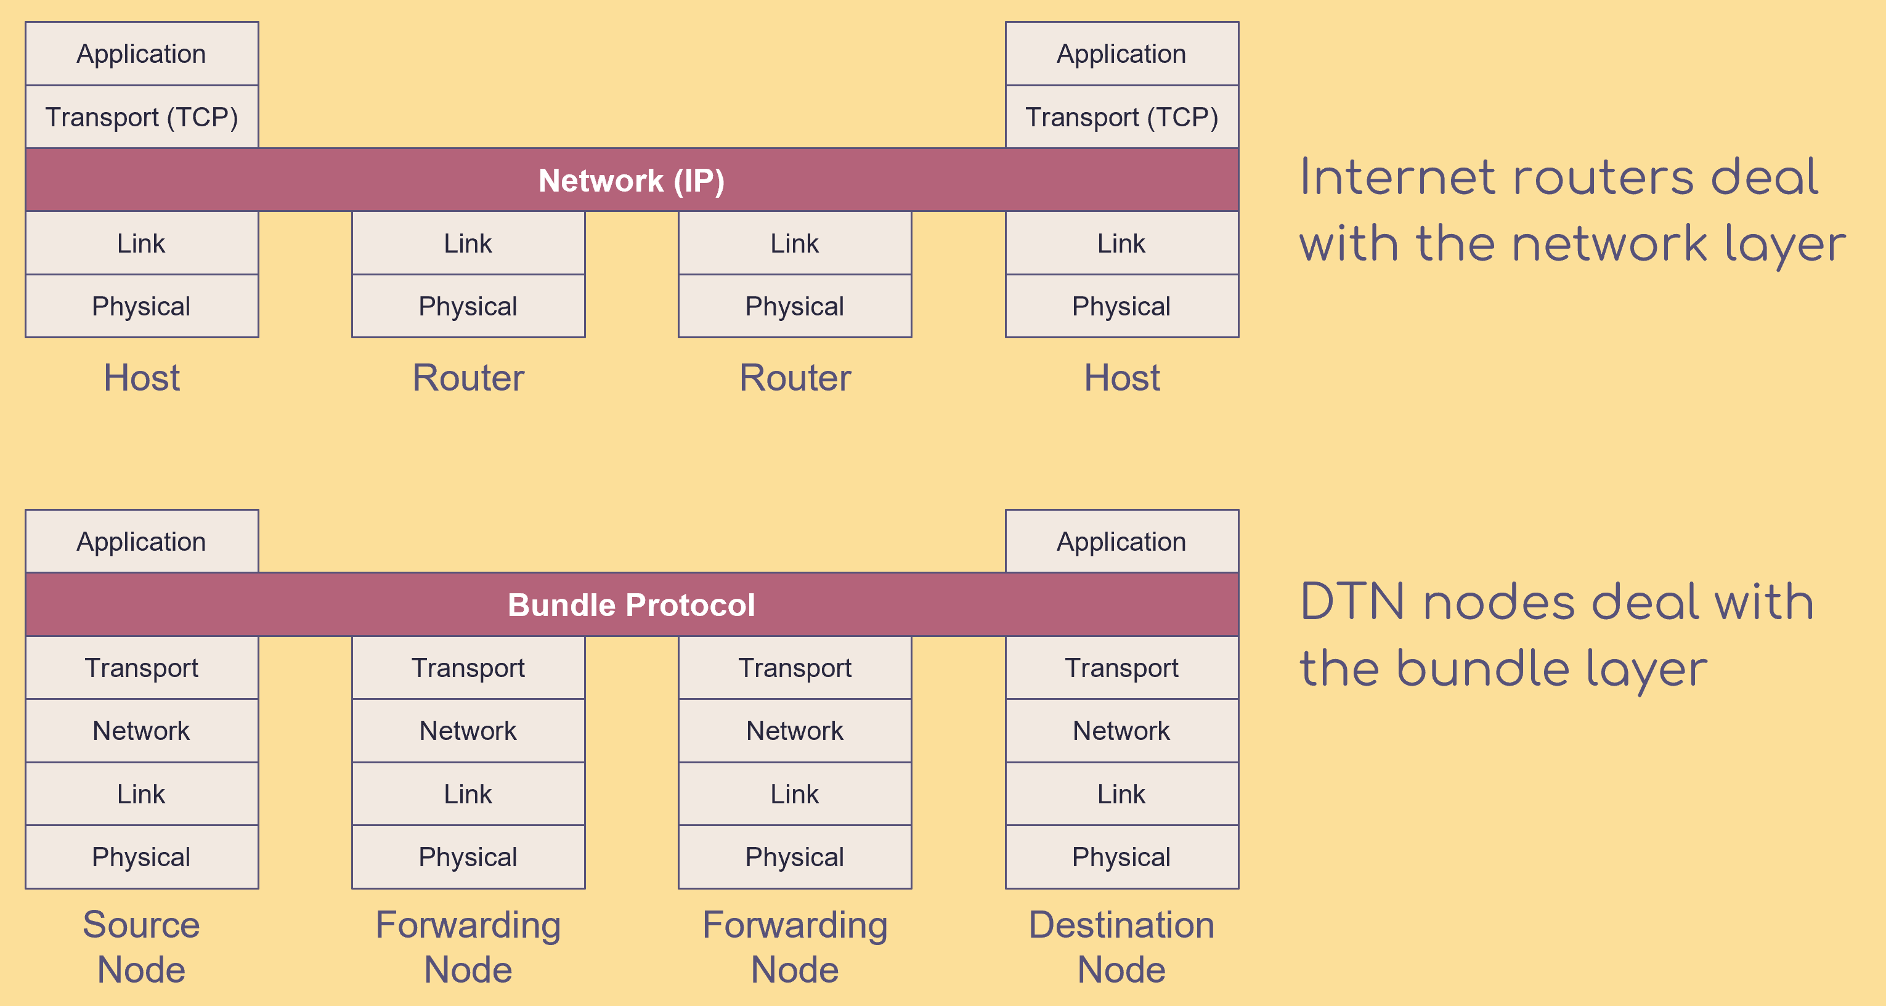
The architecture of the DTN
DTN adds a “bundle” layer on top of the transport layer. This bundle layer enables the “store and forward” feature.
Notes:
Brian Contreras

Slide 8
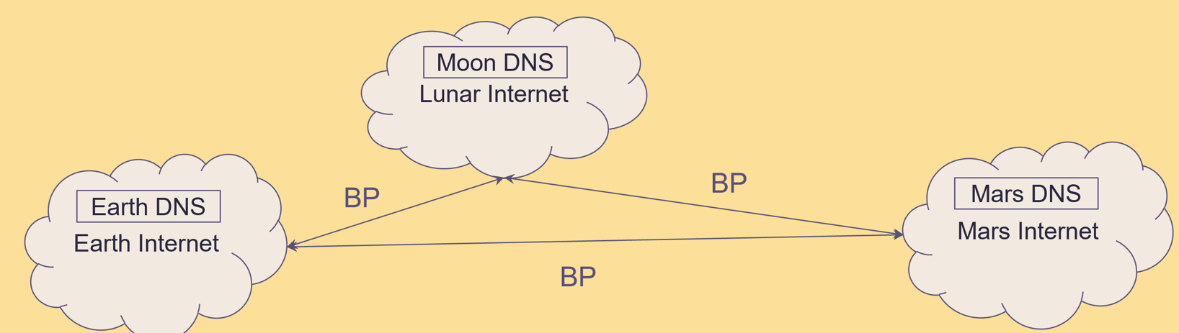
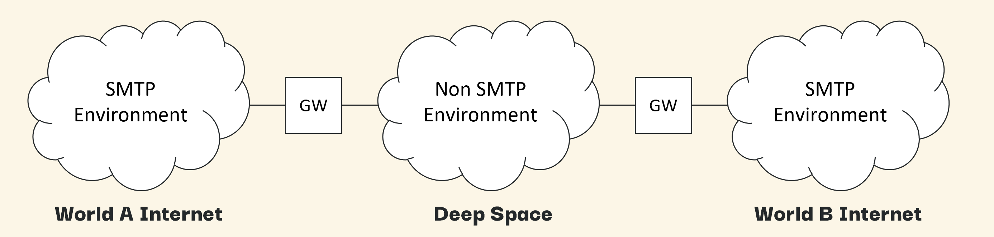
How to combining the email system with DTN?
draft-johnson-dtn-interplanetary-smtp
In Johnson’s draft, he gives a solution. He suggests that every planet has its own traditional internet (like the Internet we use on Earth), and DTN is used to connect the different planets together. The DTN network and the traditional internet on each planet are joined using gateways.
Notes:
Brian Contreras

Slide 9
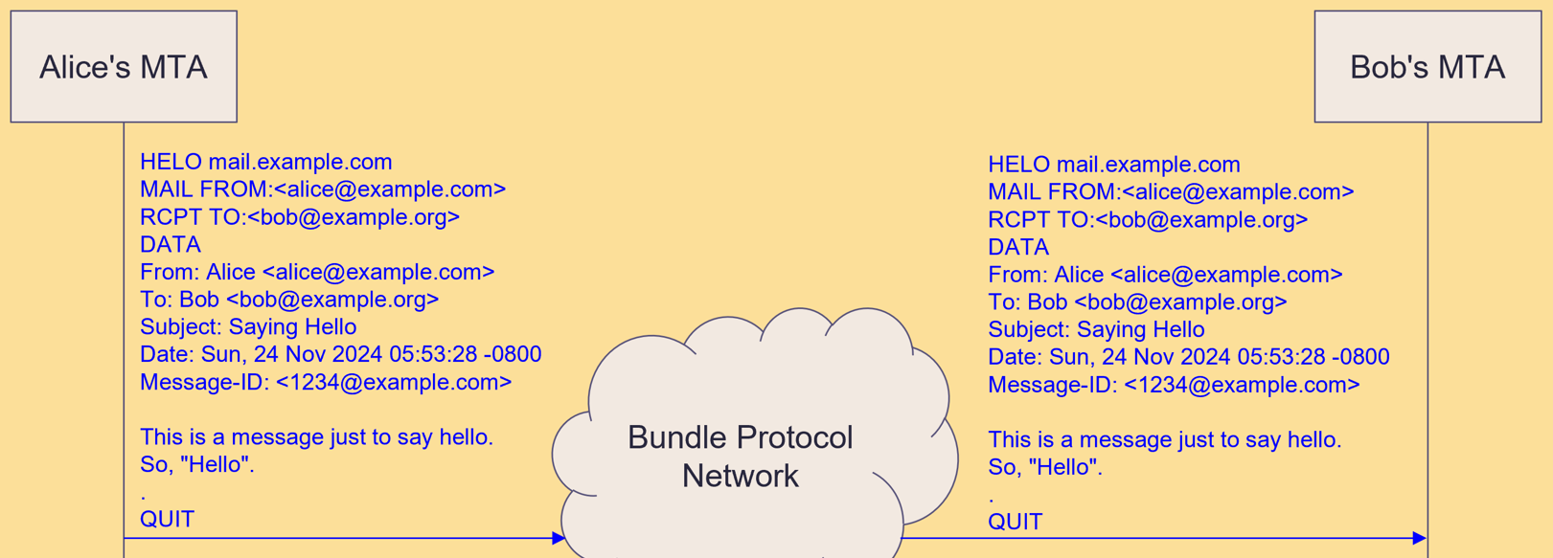
Batch SMTP
draft-blanchet-dtn-email-over-bp
To avoid the many handshakes required by SMTP, Blanchet suggested a new protocol called Batch SMTP. This protocol puts all the information that would normally be sent back and forth many times into one big message. So, you only need to send the message once, instead of going back and forth several times. Of course, for this protocol to work, both sides need to be trusted nodes. For example, in this case, the gateways are trusted, so they can use Batch SMTP to communicate.
Notes:
Brian Contreras

Slide 10
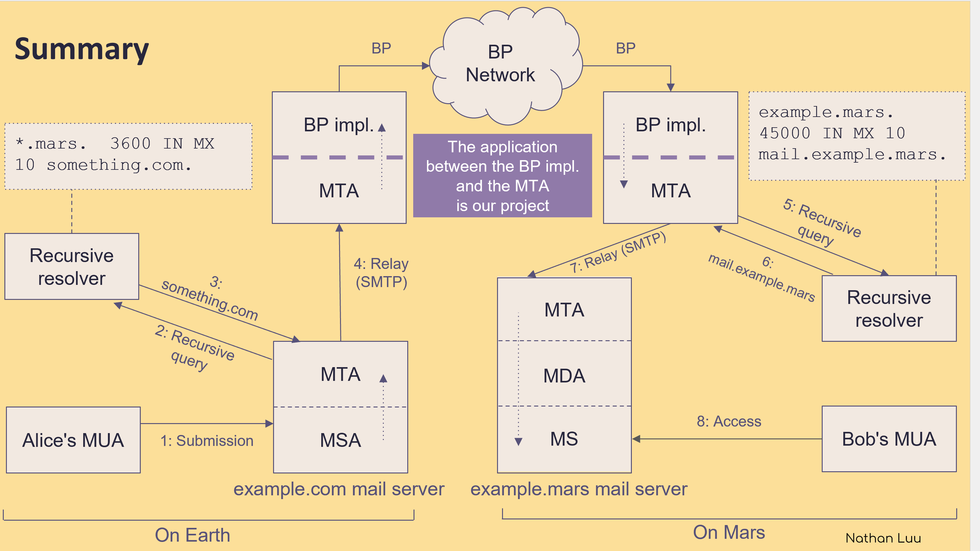
DNS
To make DNS work between different planets, Johnson suggests that each planet has its own top-level domains. When you try to look up a domain name that belongs to another planet, the DNS server just gives you the IP address of the gateway. Once your data packet arrives at the gateway on the other planet, that gateway does another DNS lookup to find the final address and forwards the data.
Notes:
Brian Contreras

Slide 11
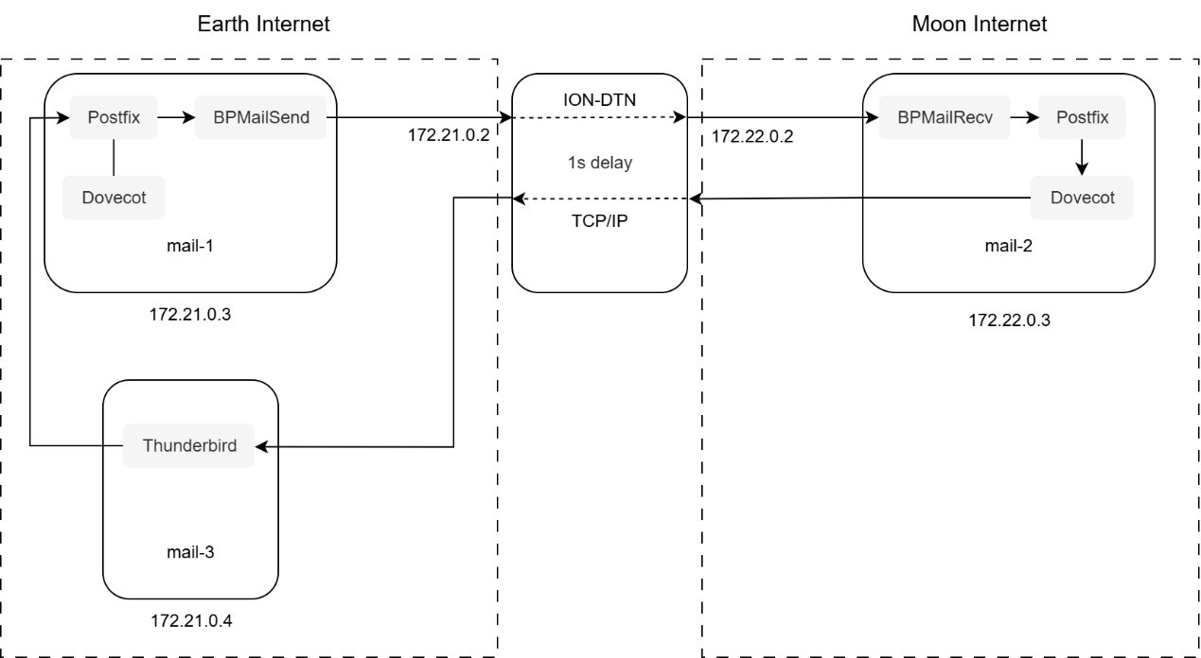

My simulation
I use Docker containers to represent mail servers on different planets. I also added another container in the middle to simulate the delay of space network. At the bottom, there’s a Docker container for the user’s client app.
I made the DNS process simpler by just using the hosts file to set the addresses of the mail servers.
Notes:
Brian Contreras

Slide 12
Here’s a basic outline of how sending and receiving an email works:
First, the email is sent from the Thunderbird client to the mail server. Postfix on the mail server gets the email and hands it over to the BPMailSend gateway app. Once the gateway gets the email, it packs it in batch SMTP format, then puts it into a bundle. This bundle is sent to the Moon through the ION-DTN. After a one-second delay, another gateway, BPMailRecv, on the Moon gets the bundle, unpacks the email, and forwards it to the Postfix mail server, which then delivers it to the user.
But, unlike Johnson’s setup, in my simulation, the recipient is not actually on the Moon—he is just traveling on Earth. Now, when the client connects to the mail server to receive emails, there’s also a one-second delay. But here, it doesn’t go through the ION-DTN network, and it needs multiple TCP handshakes. Because of this, the delay for receiving emails becomes really high.
Notes:
Brian Contreras

Slide 13
I test different one-way network delays (0s/1s/2s/5s), and record the total time required to retrieve all emails (overall retrieval time). The results are shown in the following table.
The overall download time increases linearly with network delay. When the delay is 5 seconds, the email client becomes very sluggish and is almost unusable.
To improve the email retrieval experience in deep space, it is necessary to introduce a DTN retrieval agent or a batch synchronization mechanism during the email retrieval process.
Body | Number of emails | Delay | Overall retrieval time
Hello | 1000 | 0s | 19s
Hello | 1000 | 1s | 33s
Hello | 1000 | 2s | 64s
Hello | 1000 | 5s | 153s
Notes:
Brian Contreras

Slide 14
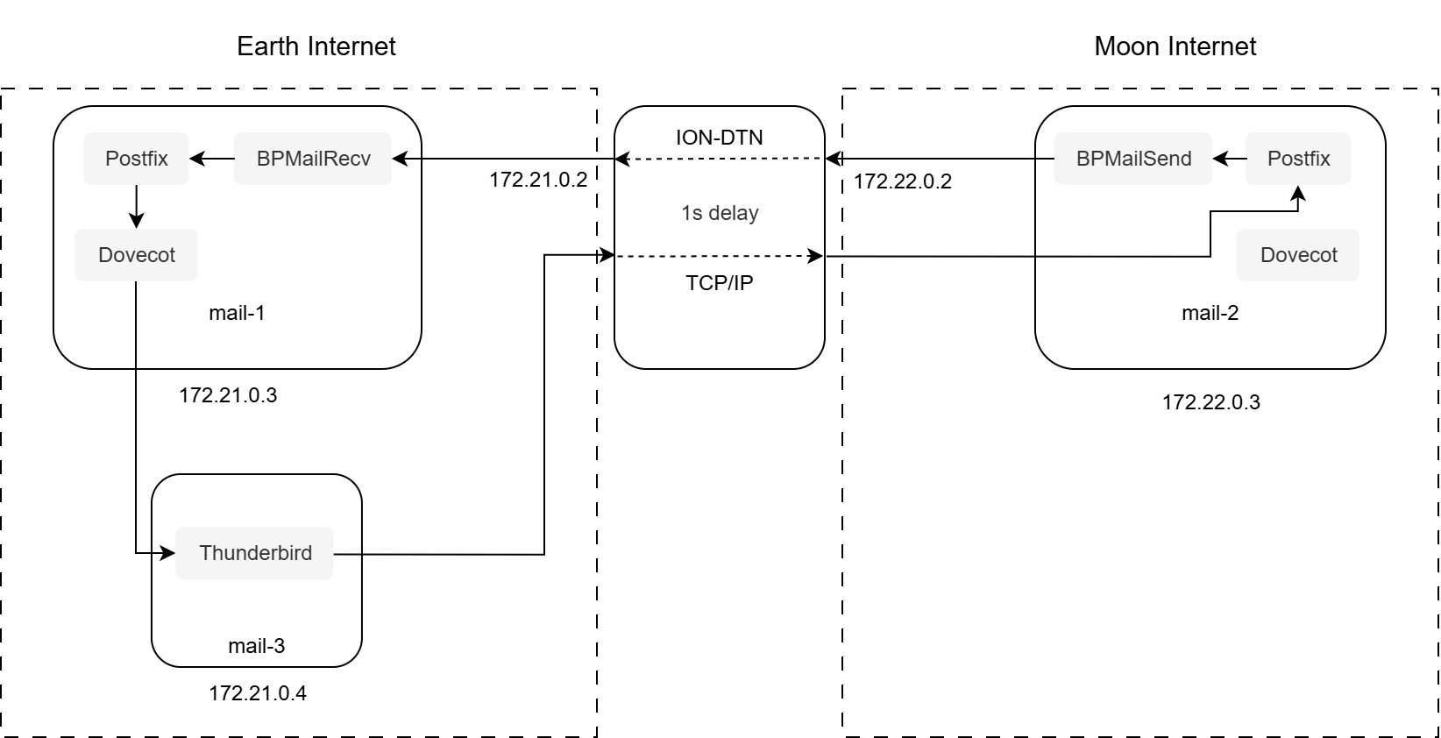
In this case, sending emails will have the same problem, too.
Body | Number of emails | Delay | Overall retrieval time
Hello | 1000 | 0s | 35s
Hello | 1000 | 1s | 57s
Hello | 1000 | 2s | 111s
Hello | 1000 | 5s | 275s
Notes:
Brian Contreras

Slide 15
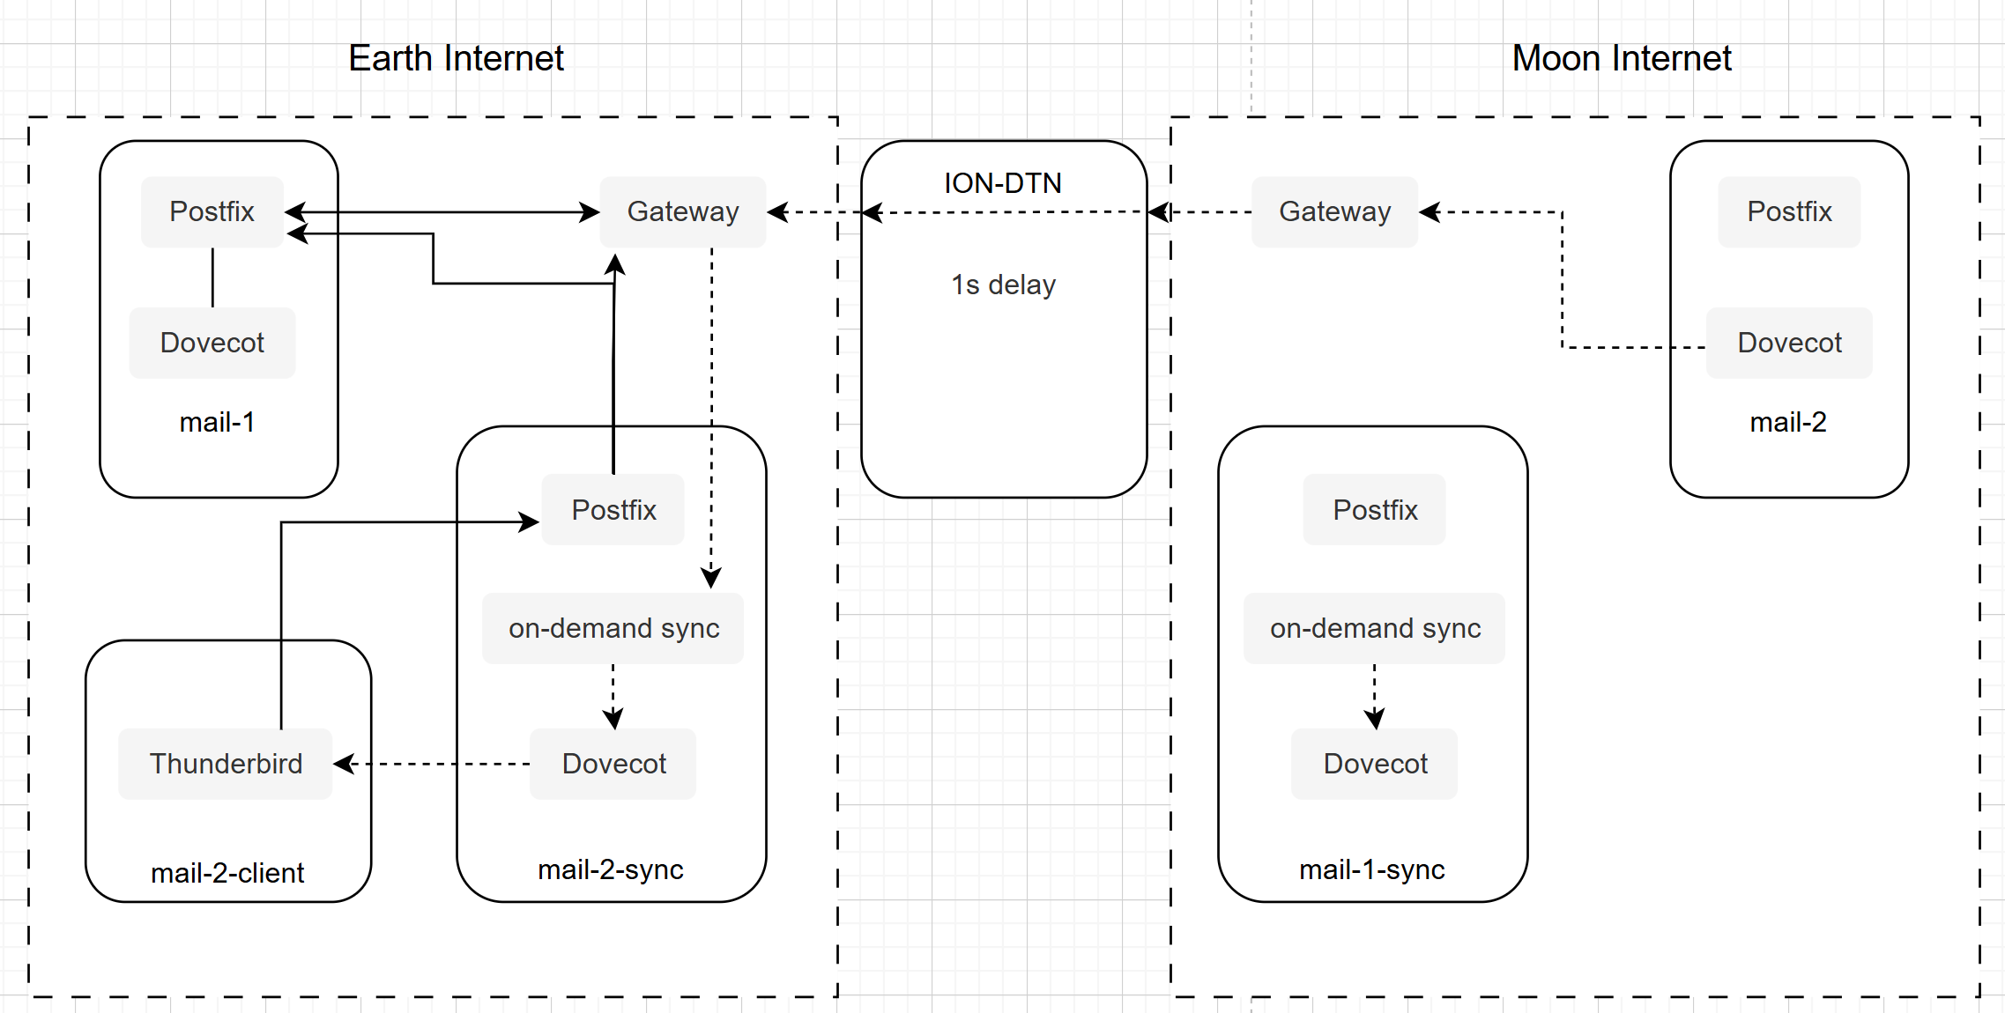
A possible solution
Set up another mail server for sending & synchronizing emails.

